Slide 1

گروه مهندسی کامپیوتر موضوع:مدیریت ریسک ارائه دهندگان: فاطمه سلیمانیان،حسین میرزاپور،نگاربشیری استاد راهنما: سرکار خانم عطیه خانجانی تاریخ:1402/02/04
بسمه تعالی

Slide 2
Table of Contents
Introduction
Types of Risks
Risk Management Process
Risk Management Tools
Risk Management Standards
Best Practices for Effective Risk Management
Case Studies
Conclusion

Slide 3
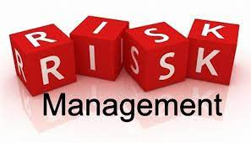
Risk management
Risk management is the process of identifying, assessing, and managing risks in order to minimize the negative impact they may have on an organization's objectives. It is a proactive approach that enables organizations to anticipate potential risks and take action to prevent them from becoming a problem.

Slide 4
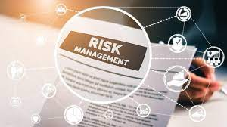
Effective risk management is important for several reasons. Firstly, it helps organizations to minimize the negative impact of risks and avoid potential financial, legal, and reputational losses. Secondly, it allows organizations to identify opportunities for growth and development. By managing risks effectively, organizations can take calculated risks that lead to positive outcomes.

Slide 5
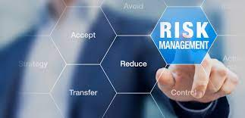
The benefits of effective risk management are numerous. These include:
Improved decision-making
Increased efficiency
Better resource allocation
Enhanced reputation
Regulatory compliance

Slide 6
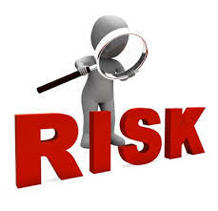
Businesses face various types of risks that can impact their operations, profitability, and reputation. Here are the different types of risks that businesses typically face:
Financial risk
Strategic risk
Operational risk
Compliance risk

Slide 7
1) Identifying Risks: The first step in the risk management process is to identify potential risks that could have an impact on the project or organization. Risks can be identified by reviewing historical data, stakeholder input, industry best practices, and project documentation 2) Assessing Risks: The next step is to assess the identified risks. This involves determining the likelihood and impact of each risk, and prioritizing them based on their potential impact. The assessment process provides decision-makers with an understanding of the risk level and allows for targeted risk mitigation strategies. 3) Managing Risks: Once the risks have been identified and assessed, risk management strategies can be developed to reduce the likelihood and impact of each risk. This could involve implementing controls, transferring the risk to a third party, avoiding the risk altogether, or accepting the risk

Slide 8
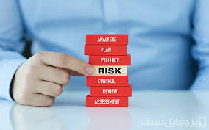

4) Monitoring Risks: The final step is to continuously monitor the identified risks to determine if the effectiveness of the risk management strategies in place. By monitoring the ongoing effectiveness of the risk management strategies, the organization can ensure that they are prepared to respond to any new or emerging risks that may arise in the future. In summary, the risk management process involves identifying, assessing, managing, and monitoring risks to ensure that an organization can respond to and mitigate potential risks that could impact its success.

Slide 9
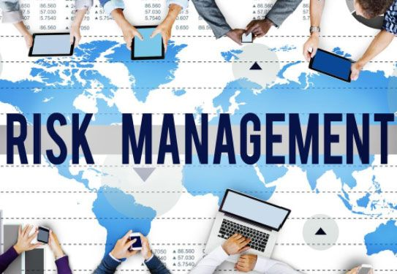
Risk management tools

Slide 10
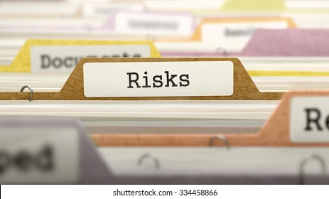
Risk Registers
risk register is a tool that businesses use to track all identified risks, including their potential impact, likelihood, and current status. It helps businesses maintain a centralized database of all the risks that they face and facilitates risk management by allowing for easy tracking and monitoring of risks.

Slide 11
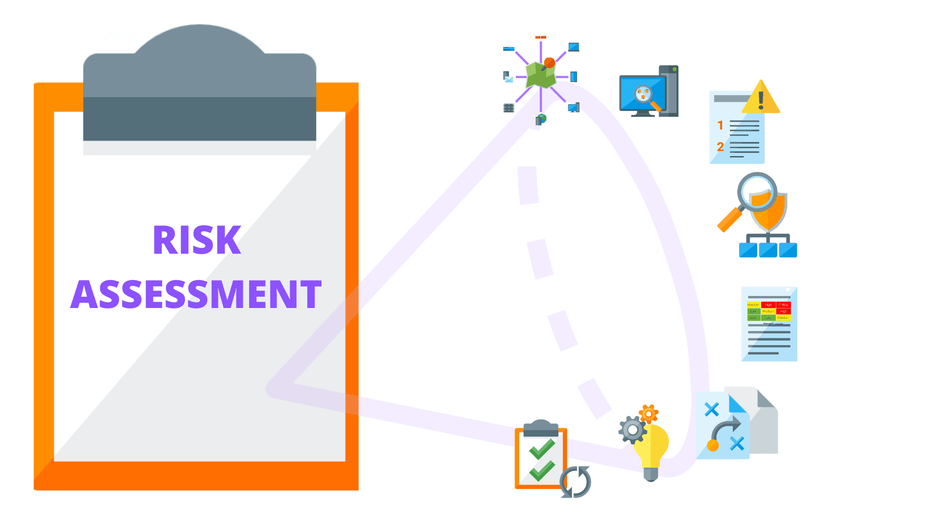
Risk Assessments
risk assessment is a process that helps businesses identify and evaluate potential risks to their operations. It involves identifying potential threats and vulnerabilities, analyzing the likelihood and impact of each risk, and determining the level of risk associated with each potential threat.

Slide 12
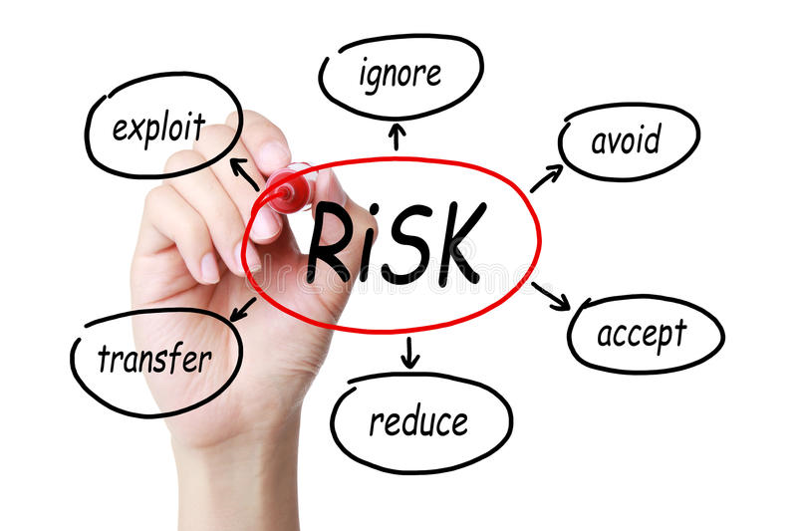
Risk Mitigation Plans
Once risks have been identified and evaluated, businesses develop risk mitigation plans to manage and minimize the risks. These plans outline specific actions that will be taken to reduce the likelihood or impact of a particular risk.

Slide 13
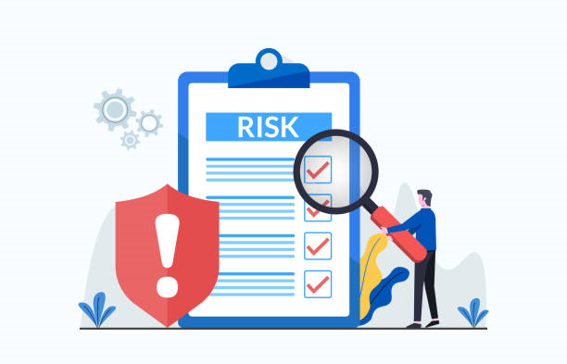
Risk Monitoring and Reporting
Risk monitoring and reporting involve continuously monitoring risks to ensure that they are being effectively managed and reporting on the status of risks to stakeholders. This helps businesses stay informed about the current status of risks and take appropriate actions when necessary.

Slide 14

businesses can use a variety of tools and techniques to manage risks effectively. By using risk registers, risk assessments, risk mitigation plans, and risk monitoring and reporting, organizations can identify and mitigate risks, thereby reducing the likelihood and impact of potential threats.

Slide 15
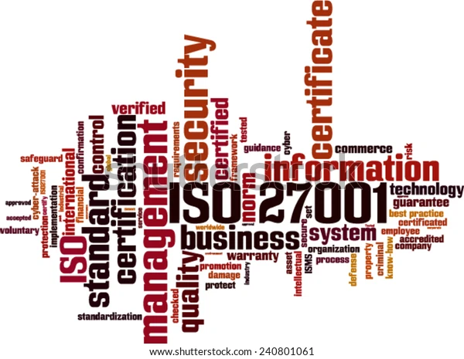
Risk Management Standards

Slide 16

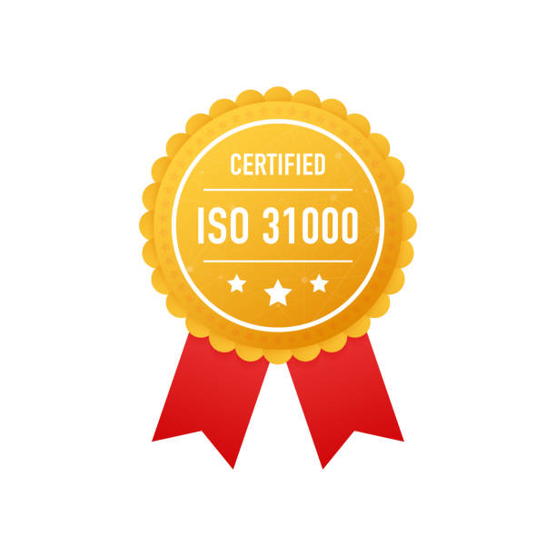
ISO 31000
ISO 31000 is an international standard that provides guidelines and principles for effective risk management. It is designed to be adaptable to different types of organizations and industries.
Establishing the context for risk management
Risk assessment
Risk treatment
Monitoring and review

Slide 17
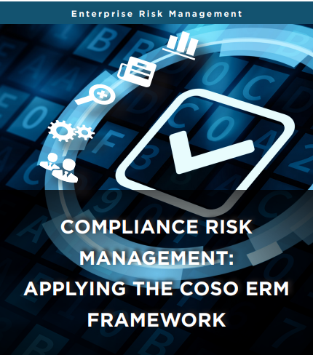
COSO ERM
COSO ERM, or the Committee of Sponsoring Organizations of the Treadway Commission's Enterprise Risk Management framework, is a framework designed specifically for enterprise-level risk management.
Internal environment
Objective setting
Event identification
Risk assessment
Risk response
Control activities
Information and communication
Monitoring

Slide 18

Best Practices for Effective Risk Management
Identifying Assessing Prioritizing Developing Strategies
Establish a risk management culture
Involve all stakeholders
Regularly review and update risk management plans
Use a systematic approach
Use data and analytics
Assign responsibility and accountability
Communicate effectively

Slide 19
Case Studies
Here are some examples of risk management in enterprise companies
Johnson & Johnson
Coca-Cola
Toyota
Airbnb

Slide 20
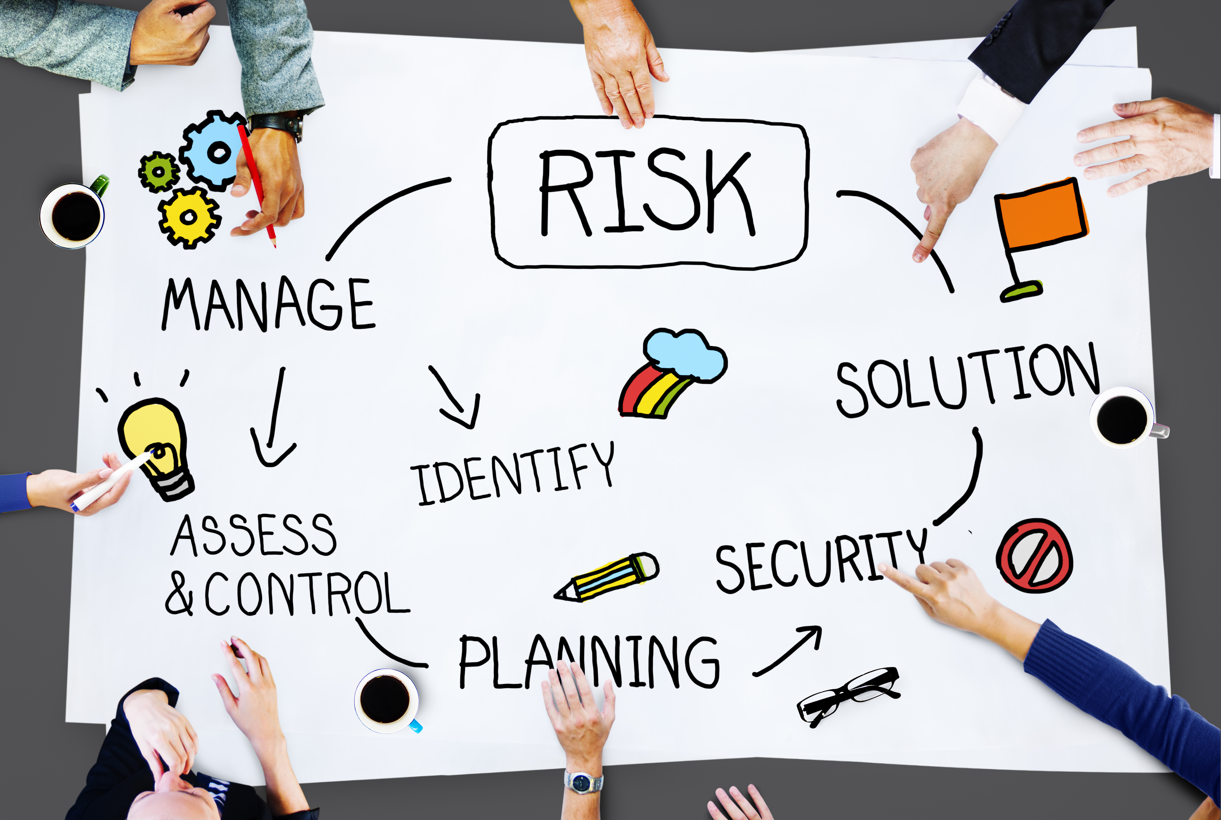
conclusion
By implementing risk management best practices, businesses can proactively anticipate and address risks, improve their decision-making processes, and achieve their goals with greater confidence and success. Ultimately, risk management is a key component of any successful business strategy, and companies that prioritize risk management are better equipped to thrive in today's uncertain and rapidly changing business environment.

Slide 21
Resources
https://openai.com/blog/chatgpt
https://www.istockphoto.com/
https://www.wikipedia.org/
https://scholar.google.com/

Slide 22


